Slide 1
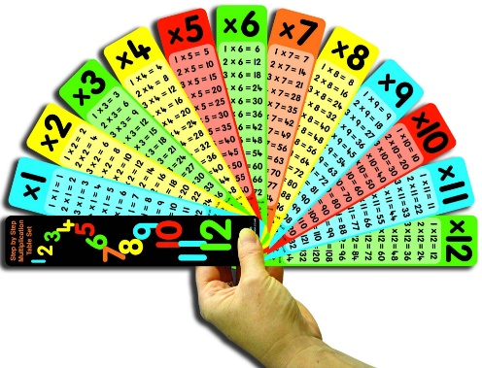
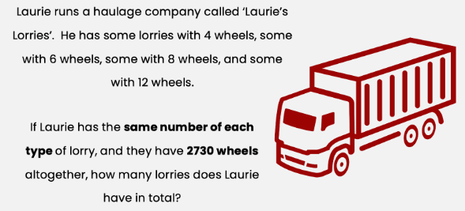
Year 4 Parent Workshop: Multiplication facts
Notes:
Welcome
While we are waiting to start, feel free to have a go at this challenge …

Slide 2
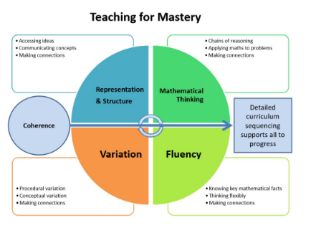
Maths at Talavera
At Talavera, we teach maths using a Teaching for Mastery approach. This means that through maths, we are supporting children to :
use different representations, structures and manipulatives to explore mathematical concepts
use mathematical language to explain and reason about their maths to solve problems
think carefully about how they solve problems and how questions may vary
make connections between different areas of maths – using what they already know to work out what they don’t know yet!
become fluent mathematicians
Notes:
Teaching for Mastery is about understanding how we do maths but also why we do maths in different ways.
There is an emphasis on why, not just finding an answer. Today the emphasis is on teaching methods that help chn understand the underlying maths, reducing the chance of mistakes and building a solid foundation for later on. Move from How to Why.
Technology is changing the world, rarely need to do a column addition or subtraction, but knowledge of when to add or subtract has increased.
Maths teaching these days tries to help children develop mathematical maps rather than remember lists of directions.
Underlying all the big ideas is coherence – teaching and learning in small steps to make the learning journey for all children manageable and connected

Slide 3
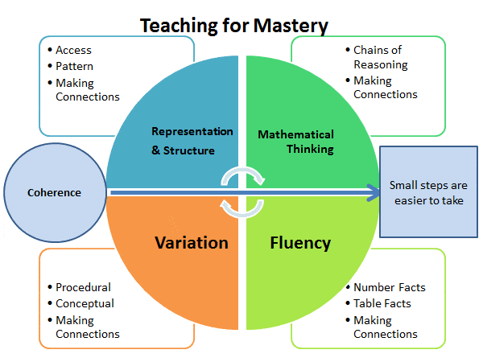
To become fluent mathematicians, children must have an efficient, accurate recall of key number facts and procedures.
Fluency demands the flexibility to move between different contexts and representations of mathematics to recognise relations and make connections and to make appropriate choices from a whole toolkit of methods, strategies and approaches.
It is about being able to recognise when to choose appropriate methods to solve problems – working smarter not harder.
If you are fluent in maths, you can:
link number bonds to adding and subtractions
use your times tables to division, fractions, percentages,
Notes:
Maths is not pages of sums in silence, more collaboration, talk and investigation.
Techniques have changed since we were probably all taught maths.
If children are fluent in mathematical concepts, their working memory is freer to think more deeply about new or unfamiliar mathematical concepts and problems and apply their knowledge to new learning.
There is an emphasis on why, not just finding an answer. Today the emphasis is on teaching methods that help chn understand the underlying maths, reducing the chance of mistakes and building a solid foundation for later on. Move from How to Why.
Technology is changing the world, rarely need to do a column addition or subtraction, but knowledge of when to add or subtract has increased.
Maths teaching these days tries to help children develop mathematical maps rather than remember lists of directions.
Fluency is how you make the connections between all areas of maths. If you understand number fluency, you can apply this to anything.

Slide 4
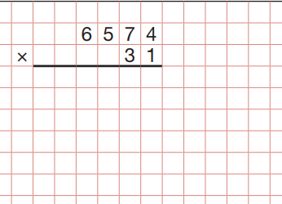
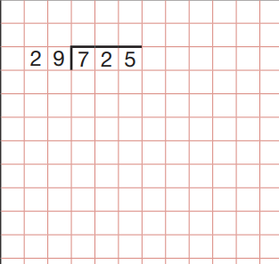
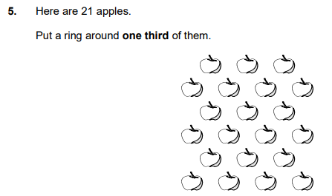
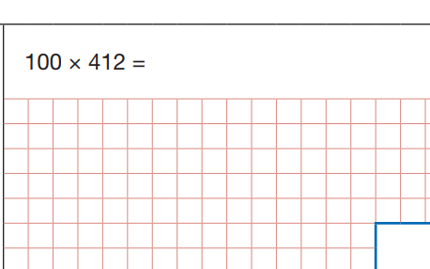
So why do they need to know their tables?

Slide 5
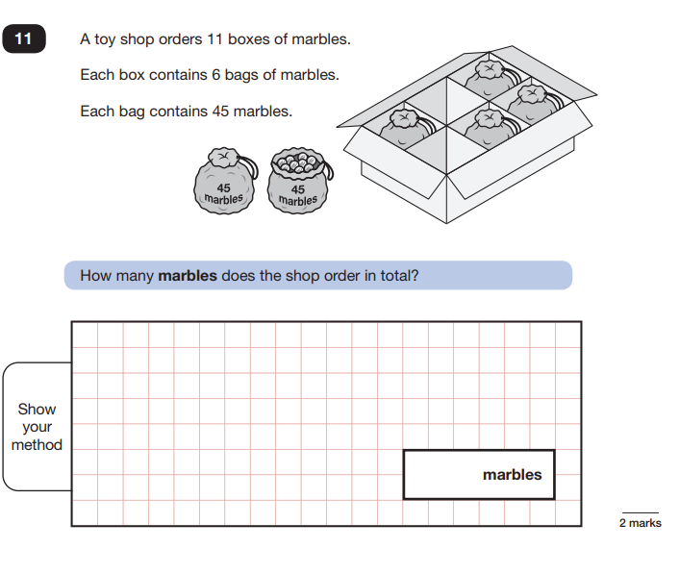
The importance of knowing the inverse!

Slide 6
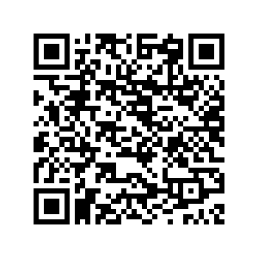
Screening test
It is now compulsory for children in year 4 to take a standard times table test in the summer term.
It will be online and on-screen so accessible on laptops, tablets and computers.
Each question will only be shown for 6 seconds before it is removed.
These tests will focus on the ‘most difficult’ times tables such as 7, 8 and 9s.
https://mathsframe.co.uk/en/resources/resource/477/Multiplication-Tables-Check

Slide 7
There are actually only 36 facts to learn!

Slide 8
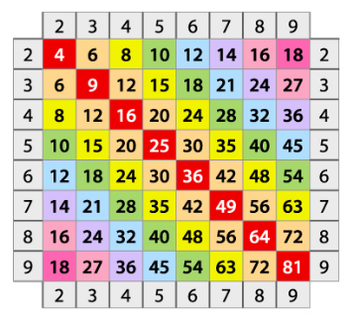
Order in which to learn …
X5 x2 x3 x7
X10 x4 x6 x9
x8
x11
x12

Slide 9
Commutative Law
A key mathematical concept to grasp is realising that the order of multiplication doesn’t matter
Commutativity has the same origins as commuter – both based on the idea of back and forth)
So 3 x 7 = 7 x 3………

Slide 10
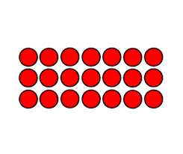
The best way to show this is with an array. We could also say this as: 3 groups of 7 = 21 7, 3 times = 21 in total 21 shared between 3 groups = 7 in each group 21 divided into groups of 7 = 3 groups
3 x 7 = 7 x 3

Slide 11
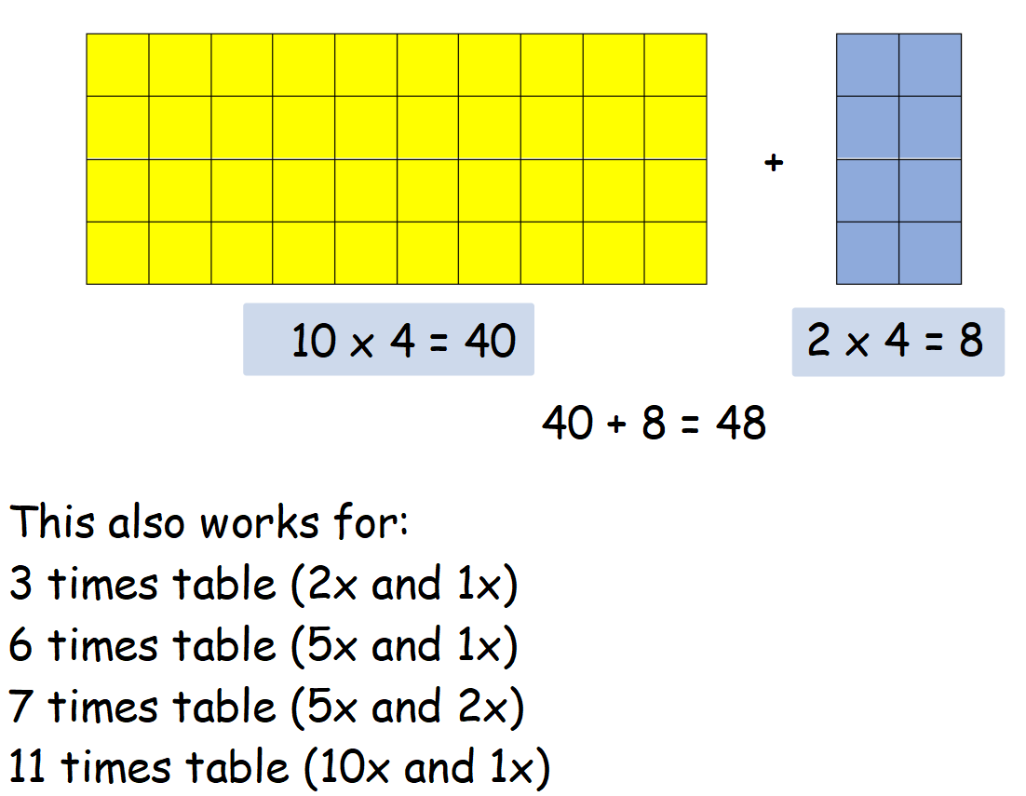
Distributive Law

Slide 12
Distributive Law To help the children with using the distributive law, we use a strategy called 1, 10, 5 derive.

Slide 13
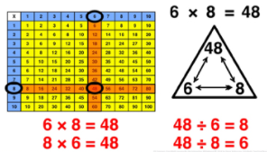
Fact families
Notes:
AW

Slide 14
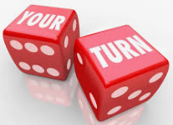
Tasks – Counting Stick
Practise counting up in different multiples.
Rub out some of the multiples, can the children tell you which numbers you have rubbed out.
Encourage them to use known facts to solve those they do not know.
GAME: Wipe out
Each start with a complete counting stick with your chosen times table.
Take it in turns to roll a dice and create a calculation e.g. 3 x 6.
If you can complete the calculation correctly, you get to rub the answer off your stick.
However, if you roll the same number again, you must write it back on your stick.
The winner is the first person to clear their counting stick.

Slide 15
Task – Dice
Roll the 1-10 dice twice.
First player to multiply the numbers gets the point.
First to 10 points wins.
Step up:
Roll the dice and recall a division fact linked to the number.

Slide 16
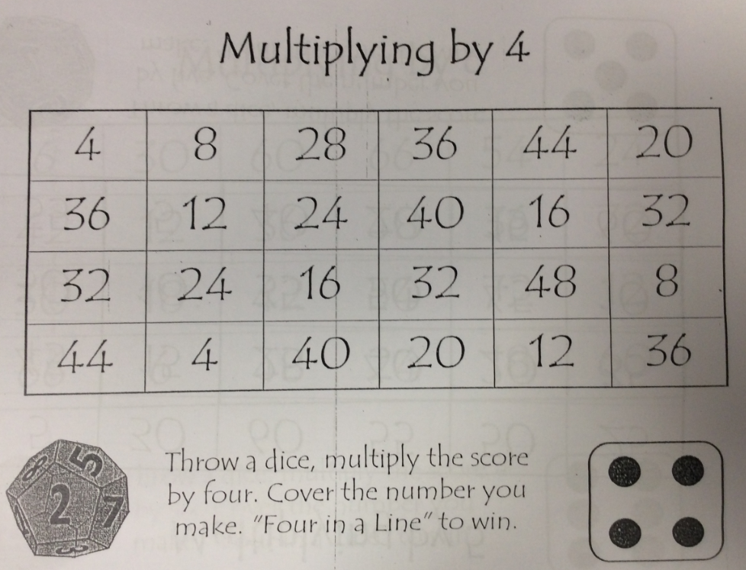
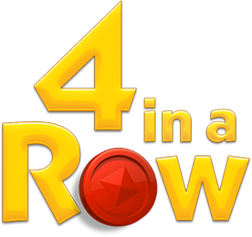
Task – 4 in a row
Or mathematical connect 4
Take it in turns to roll the dice.
Multiply the number on the dice by the game you are playing and place your colour counter on the answer.
First player to get a line of 4 counters wins.

Slide 17
Multiplication Dice Bingo
6 | 24 | 36
12 | 60 | 42
Make 2 by 3 grids
Choose a times table to practise
Each player writes down 6 facts for the chosen times table
Roll the 1-12 dice and multiply the chosen factor by that number
Cross it out if the product is on your grid
First to cross out all 6 wins

Slide 18
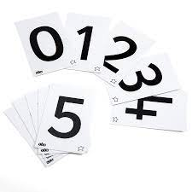
Task – Card game
Create 2 sets of 0 – 12 cards in different colours.
Each player turns over a card at the same time.
The first player to correctly multiply the numbers together wins the cards.
The winner is the one who collects all the cards.

Slide 19
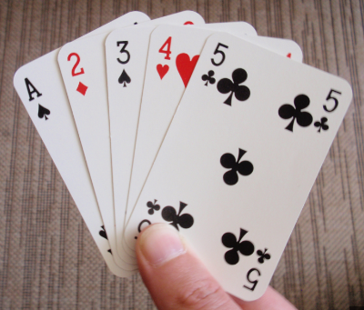
Task – Card game 2
One for all the family!
Playing with at least 3 of you, 2 people take a card each and hold it on their foreheads so that they can see the other card.
The 3rd person multiplies the 2 cards together and says the product.
The first of the 2 people with the card to guess their own number using their knowledge of the other person’s card, wins the card!

Slide 20
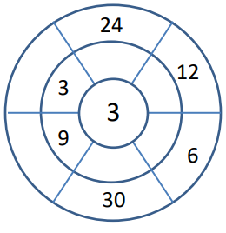
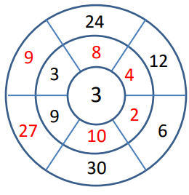
Target boards
Place the times table in the middle.
Children complete the target board or you may fill in some of the sections and get your child to finish it.

Slide 21
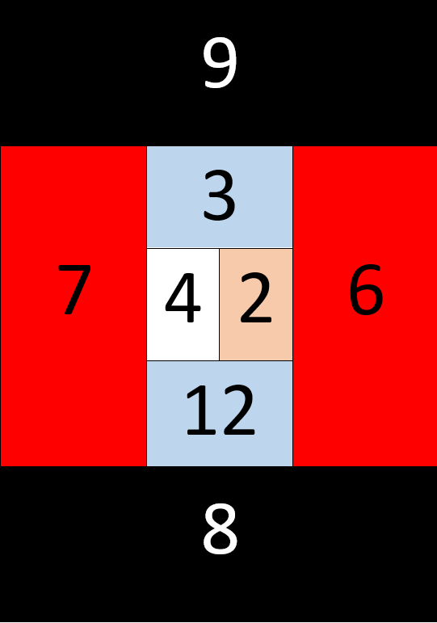
Board games
These can be tailored to whichever times table your child is working on (including division facts) to provide a wider range of activities to develop fluency.

Slide 22
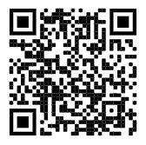
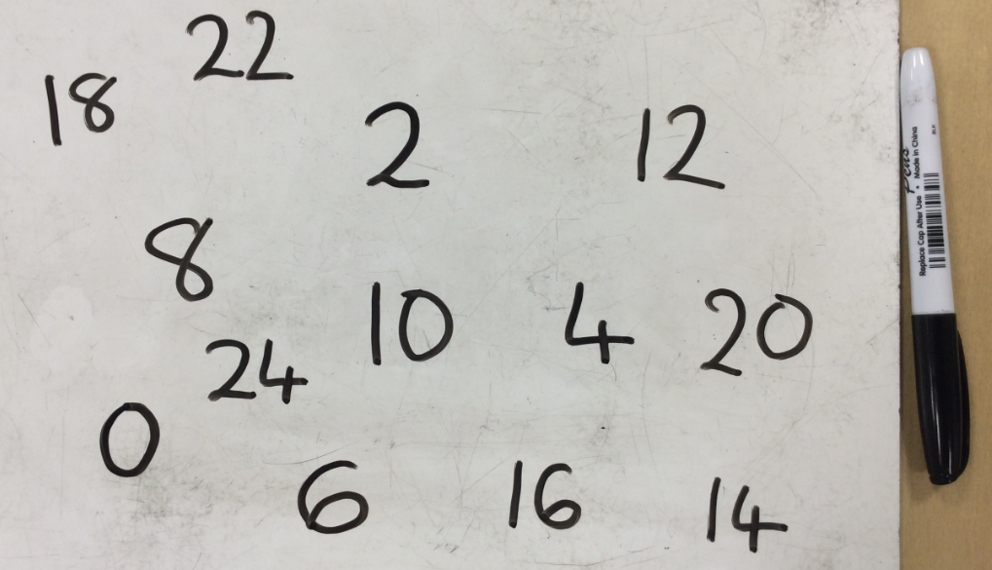
Websites
https://www.topmarks.co.uk/maths-games/hit-the-button
Alternatively you could play the same game offline using your whiteboard and pen.

Slide 23
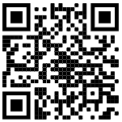
Websites
https://play.ttrockstars.com/auth/school/student
Such a great resource and obviously children will have participated in our first Battle Day today!
You should have been given your child’s login details at the Parents Evening but please just ask your child’s class teacher if you need them again.

Slide 24
And finally!
Try to have a growth mindset.
It’s ok to struggle and make mistakes; that’s when we learn.
Maths is taught very differently today to how we may have learnt strategies but what is important, is that we encourage our children to have a go.

