Slide 1
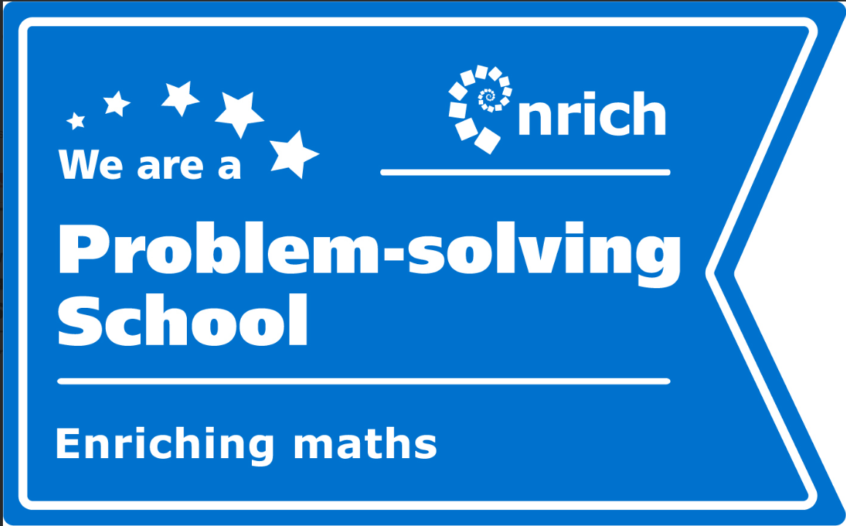
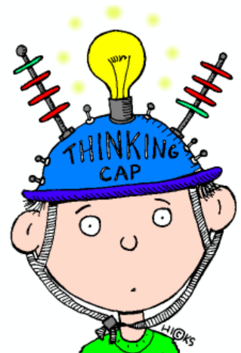
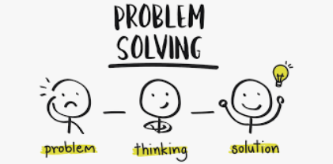
Year 6 Parent Workshop - Maths
Reasoning and Problem solving strategies

Slide 2
Can you help me with my maths homework please?
Why do they do it differently these days?
It’s the difference between providing someone with a list of instructions for getting from A to B and providing them with a map
Notes:
A question that may fill us all with dread as maths is taught very differently to how we may have learnt it at school ourselves
Maths lessons are not about completing as many calculations as possible in silence or chanting our tables by rote (though this does have a place); they are more about collaboration, talk and investigation.
Techniques have changed
There is now an emphasis on why, not just finding an answer.
Today the emphasis is on teaching methods and processes that help chn understand the underlying maths, reducing the chance of mistakes and building a solid foundation for later on.
It is a shift from understanding the how to why.
Technology is changing the world, rarely need to do a column addition or subtraction, but knowledge of when to add or subtract has increased.
Maths teaching these days tries to help children develop mathematical thinking, make connections and understand different representations – think of it as creating a mathematical map rather than remember lists of directions.
Problem solving and reasoning falls within the Mathematical Thinking idea but also has making connections which runs through all of them

Slide 3
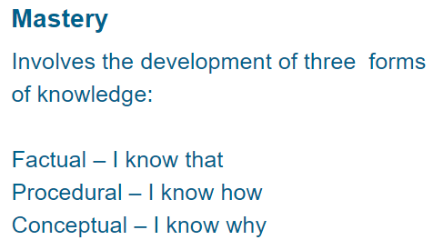
Maths Mastery involves …
For example:
If I know that 3 x 6 = 18, I know how to multiply 3 x 60 = 180 because I know that one of my factors is 10x bigger so my product has to be 10x bigger.
Notes:
It is about these forms of knowledge individually but also seeing how we can make connections across mathematical concepts to help us “use what we know to work out what we don’t know”!
For example: I know that a fraction is part of a whole; so I know how to add fractions with the same denominator by just adding the numerator because I know that the number of parts in my whole hasn’t changed etc

Slide 4
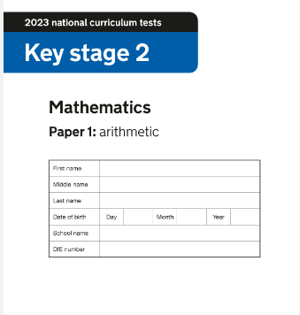
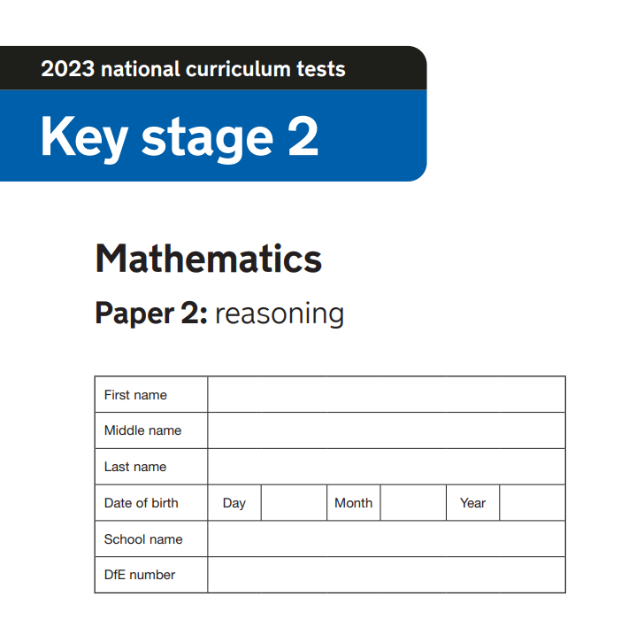
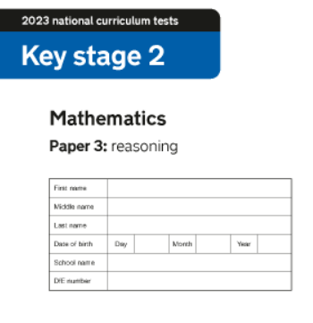
Why are we focusing on reasoning?
Notes:
Now I know SATS are not the be all and end all (and we did survived 2 years without the children doing them!) but they are back and the reality is your children will have to sit them.
SATS – w/c May 13th; arithmetic is out of 40; 2 reasoning papers worth 35 marks each = 110 overall
3 papers of approximately 35 questions in each at in 30 – 40 minutes eg: about a minute per question so there isn’t time for them to work each of these out using formal strategies.
Questions are drawn from mathematical concepts taught in all year groups in KS2 so it’s about applying that knowledge learnt throughout their KS2 journey
Only 36% of the content of the papers in 2023 came for Y6 objectives/concepts solely taught in Y6

Slide 5
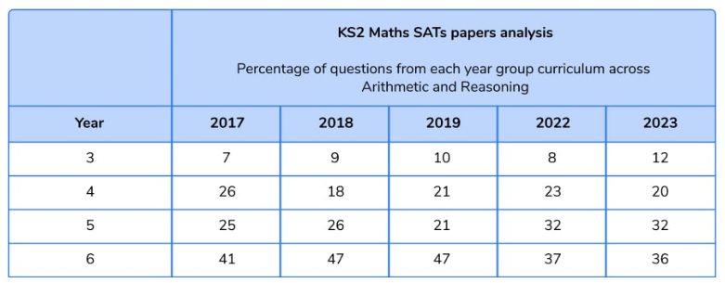
Where do the questions come from?
Notes:
The possibility of passing the test without any knowledge of the Year 6 curriculum was clearly higher in 2023 than it has been in any of the years previously.
The expected standard could be achieved with no Y6 maths – Third Space Learning
This year, the pass mark was 51%, with 64% of the paper being from Years 3 to 5. If we look back to 2019, the pass mark was 53%, with 52% of content being from Year 3 to 5.

Slide 6
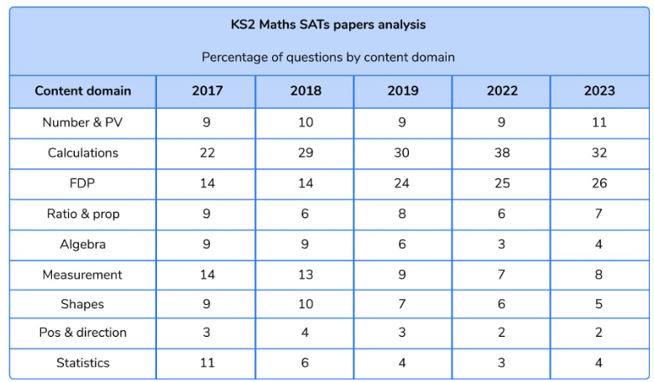
What sort of questions will my child be asked?
Notes:
Calculations and Fractions, Decimals and Percentages have consistently been the maths concepts that appear most frequently in both the arithmetic and reasoning papers.
Although 2023 is not on the breakdown, it followed exactly the same structure as 2022.
In the arithmetic papers these types of questions may vary from:
______ = 10 x 96 to _____ = 6138 + 456

Slide 7
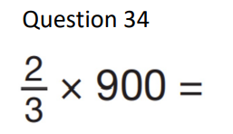
What skills do they need to be able to reason more mathematically? 1. Understanding the language eg: times means of 2. Identifying the maths involved eg: finding a fraction of an amount not multiplying fractions 3. Completing all the stages and steps involved
Notes:
Similar questions are presented throughout the test, just in different ways so children need to understand and become used to this
Questions may increase in difficulty the second or third time they are presented so children need to reason around the connections they can make to help them identify how the questions are similar (both adding fractions or finding percentages in the examples above) but also how they can draw up strategies used in the ‘easier’ questions to work out the trickier ones.

Slide 8
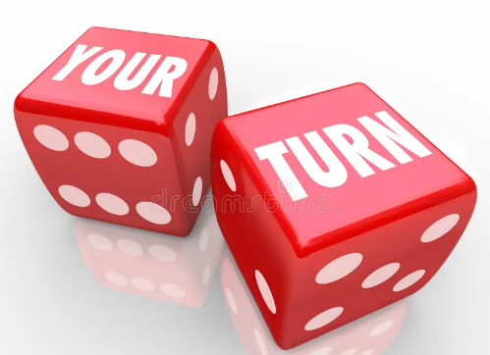
What skills do they need to be able to reason more mathematically?
Understand the language
Identify the maths
Complete all the stages of the problem
Notes:
It’s the same with the reasoning papers, comments have been made in the media about the wordiness of some of the papers in recent years. Children were able to do the maths involved once they’d unpicked the language and identified the maths behind what was being asked.
L

Slide 9
Focusing on fractions, decimals and percentages
Part whole numerator denominator
Equal out of 100 tenth hundredth
More than less than difference between of
Unit fractions Non-unit fractions improper
Mixed number equivalent simplify
Highest common denominator factor multilple
Product decimal per cent times
Notes:
So what do these words all mean? Are they familiar to you / your children?

Slide 10
1. Understand the language

Slide 11
1. Understand the language

Slide 12
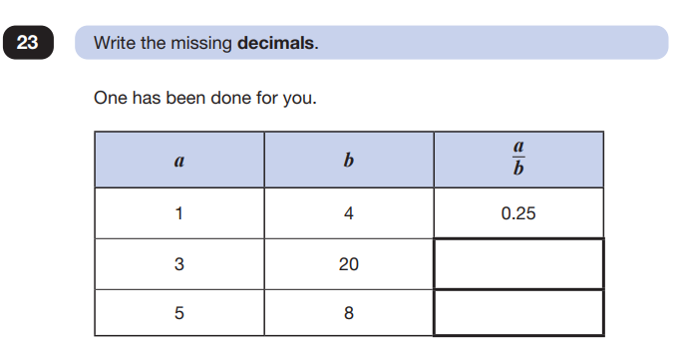
2. Identify the maths involved
Notes:
Think about what it is you already know to help you answer these questions.
We instil in the children that the greater the denominator, the smaller the part so for some of the questions, can you apply this generalisation or do you need to work out the number of sweets or to re-arrange the fractions?
Can you make connections between other areas of maths – for question 23, can you remember that b is your denominator, a is your numerator. When 20 and 8 are denominators, how many times are they multiplied by to get to 100 / 1.00 etc
Thought re: not being asked these exact questions but similar one so what if the numbers were …., would I still be able to apply the same knowledge and understanding to help me solve the problem?

Slide 13
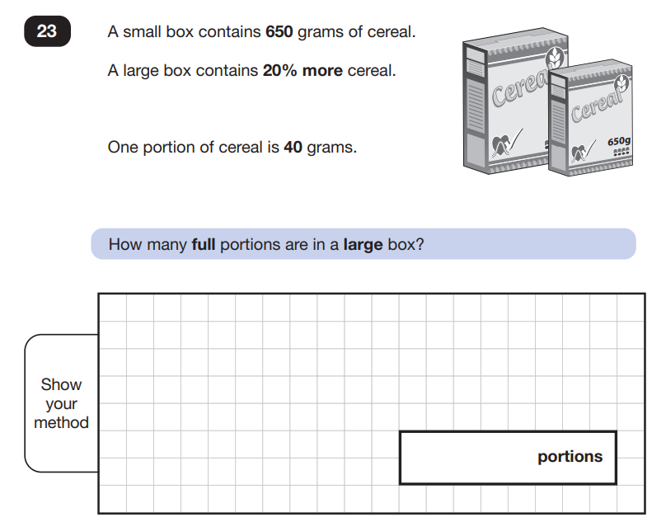
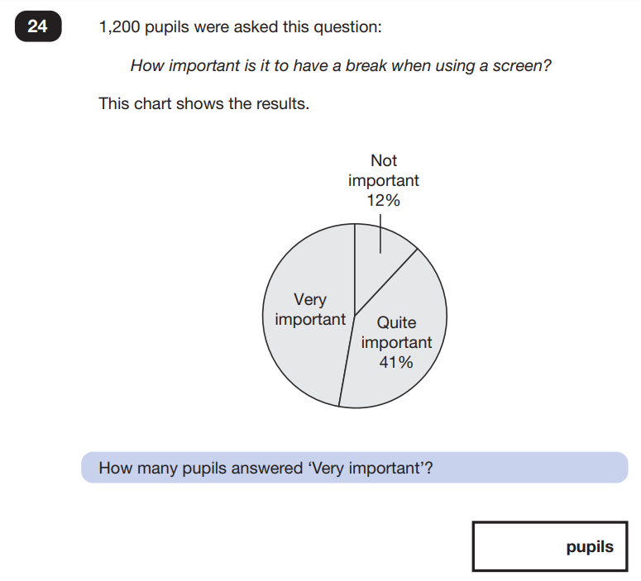
2. Identify the maths involved
Notes:
Think about what it is you already know to help you answer these questions.
Remember to unpick the language and make sure you understand what it is you’re being asked to do
What connections can I make between maths I already know to work out what I don’t know YET

Slide 14
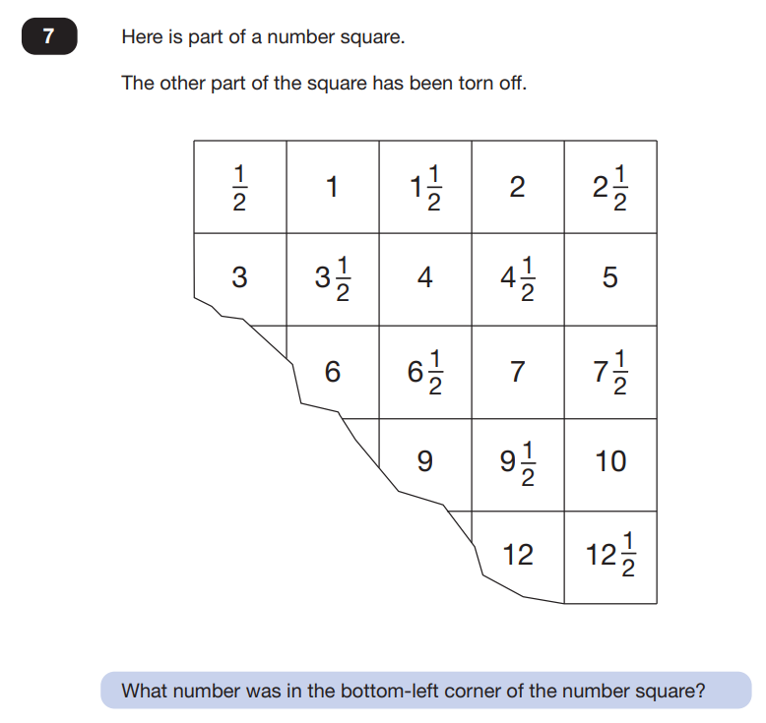
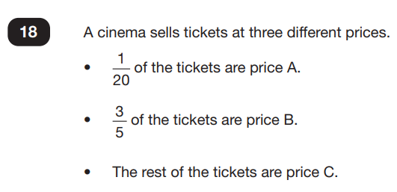
2. Identify the maths involved

Slide 15
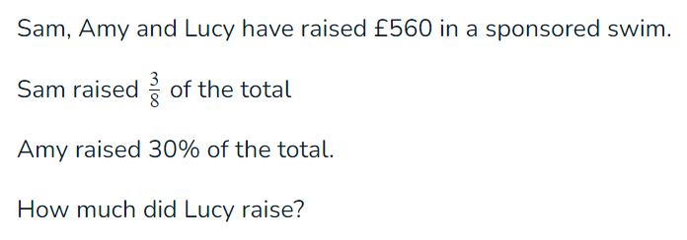
3. Complete all of the stages of the problem
Notes:
It is always worth looking at the number of marks each question is worth as it may give an indication of how many steps there are to complete – the more marks, the more steps. But not always!
Highlight the key words and numbers
Maybe identify first I …. Then I … Next I … / Finally I ….

Slide 16
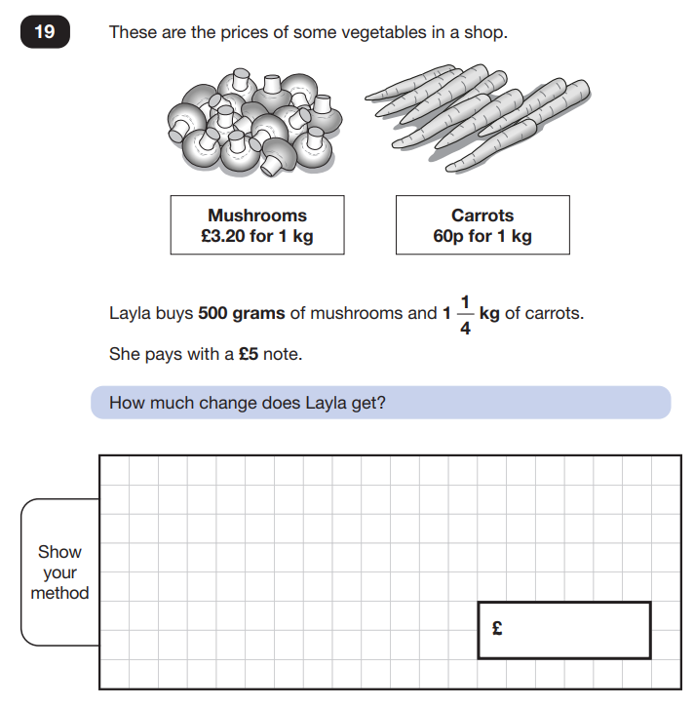
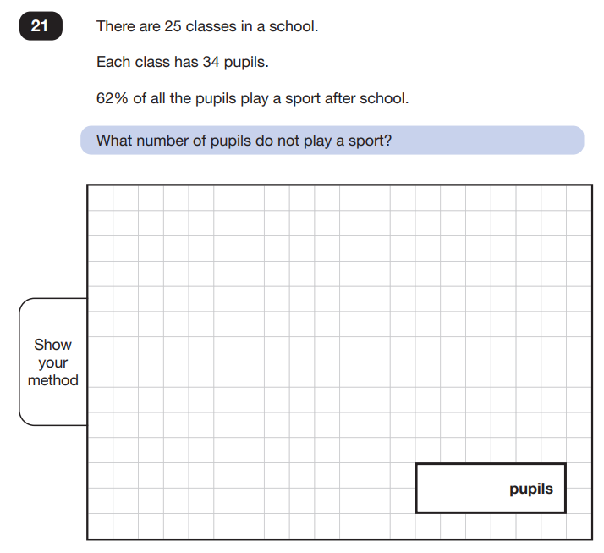
3. Complete all of the stages of the problem
Notes:
It is always worth looking at the number of marks each question is worth as it may give an indication of how many steps there are to complete – the more marks, the more steps. But not always!
Highlight the key words and numbers
Maybe identify first I …. Then I … Next I … / Finally I ….

Slide 17
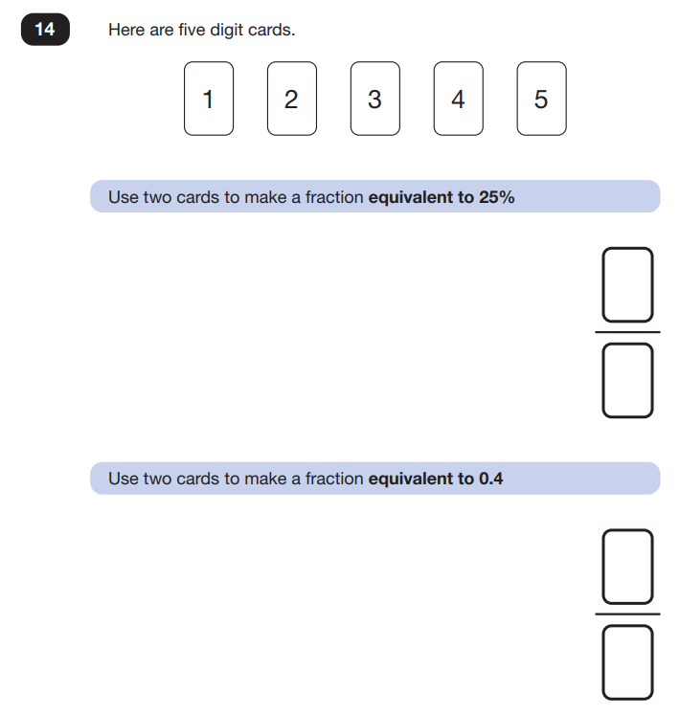
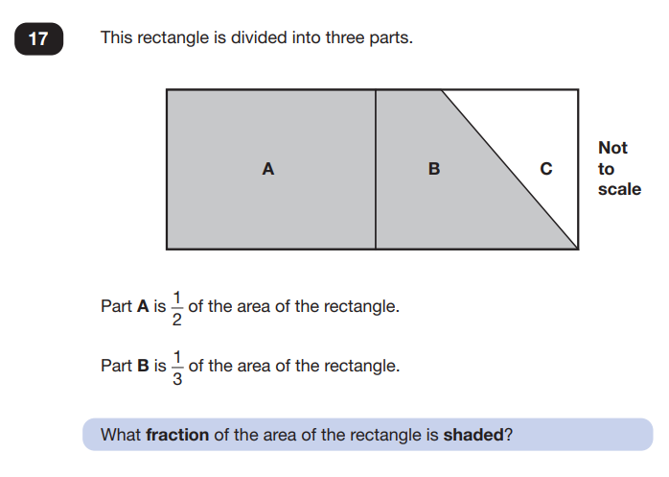
3. Complete all of the stages of the problem

Slide 18
It is also important to remember, your children are not going to be asked these exact questions again.
Therefore they need to apply their understanding of the concepts behind fractions, decimals and percentages in order to unpick the maths in the questions they will be asked.
“Use what you know to work out what you don’t know!” – chanel your inner Mr Hutson!

Slide 19
Things to try at home:
Converting between fractions, decimals and percentages – counting stick models https://mathsbot.com/manipulatives/countingStick
Asking would you rather … type questions
eg: would you rather have ½ of £30 or 2/3 of £24? Why?
Asking what if … type questions when you’re out shopping eg: What if there was 25% off the cost of this new top you’d like?
Use playing cards to generate fractions which can be ordered, multiplied, added etc; practise converting into decimals and percentages
Notes:
Demonstrate counting stick with post-its hanging down with fractions eg: tenths, decimals eg: 0.1, 0.2 etc and percentages eg: 10%, 20% etc
Give parents in their packs different types of counting sticks

Slide 20
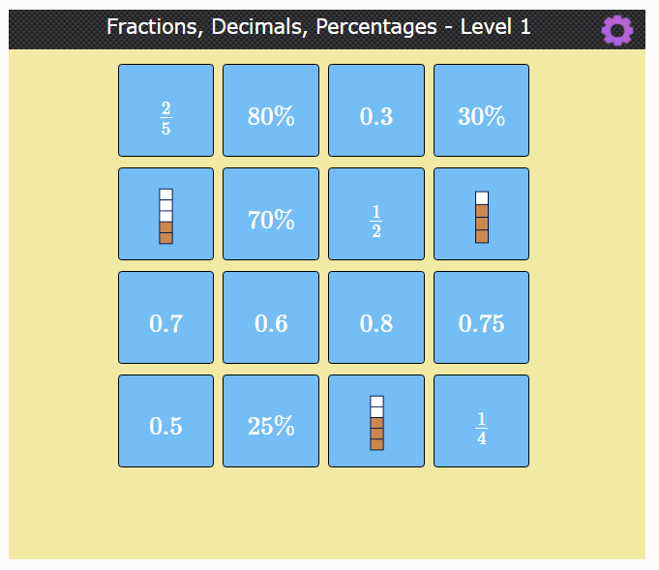
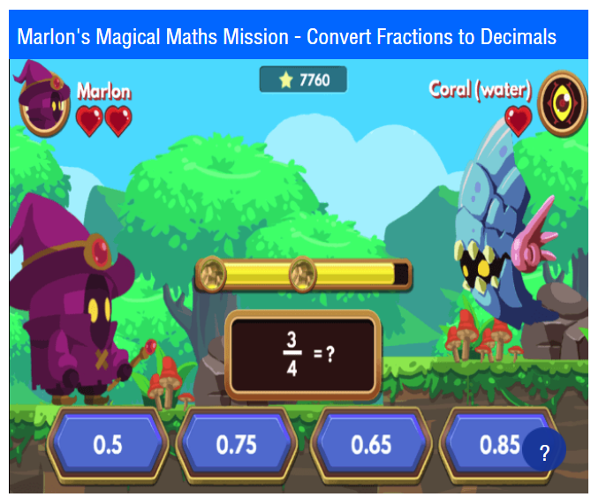
Things to try at home:
Games
Topmarks website
https://www.topmarks.co.uk/maths-games/7-11-years/fractions-and-decimals
Mathsframe website for a range of games
https://mathsframe.co.uk/en/resources/category/18/fractions-decimals-and-percentages
Nrich website for investigations
https://nrich.maths.org/1249

Slide 21
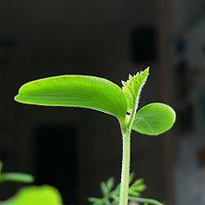
And most importantly – don’t panic!
Notes:
Growth Mindset Believes:
Learning requires HARD WORK and EFFORT
ALL individuals CAN LEARN and improve
We CANNOT MEASURE a person’s POTENTIAL

Slide 23
